Slide 1


Loan Default Prediction
Denizhan Özyurt
Ezgi Berksoy
Ömer Bahar
Ozan Yağcılar
Zeki Berkay Saygın

Slide 2
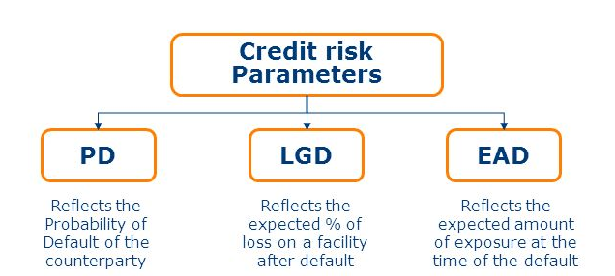
Kaggle Case: Loan Default Prediction
Case: Kaggle Competition from Imperial College of London, 5 years ago (link)
Objective: predicting whether the loan will default or not by looking at 776 anonymous features
Data: 105,471 observations for 776 features and “loss” label. 653 of these variables were in float type, 99 was in integer type and 19 was in object type.
Why Loan Default Prediction: knowledge-abundant and challenging topic as there are a great number of people working on the topic
Performance: We used Random Forest Model and got cross validation score of 90.66%. That’s worse than the most, but at least we made it work.

Slide 3
Method: Random Forest Classification
Selecting the right model: We discussed upon 4 different models. Since we had a lot of features and our features were anonymized already, it was a good idea to pick something that is inherently randomized. Also Mr. Dalaman suggested to Random Forest as well. :-)
Library: We used random forest functions from scikit-learn libraries
Decision Trees: Supervised learning algorithms used for classification
Random Forest: Builds an ensemble of decision trees to find the most accurate and stable prediction
Logistic Regression
K-nearest Neighbour Class.
Random Forest Class.
Support Vector Machine

Slide 4
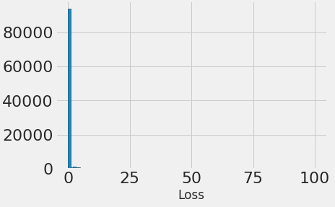
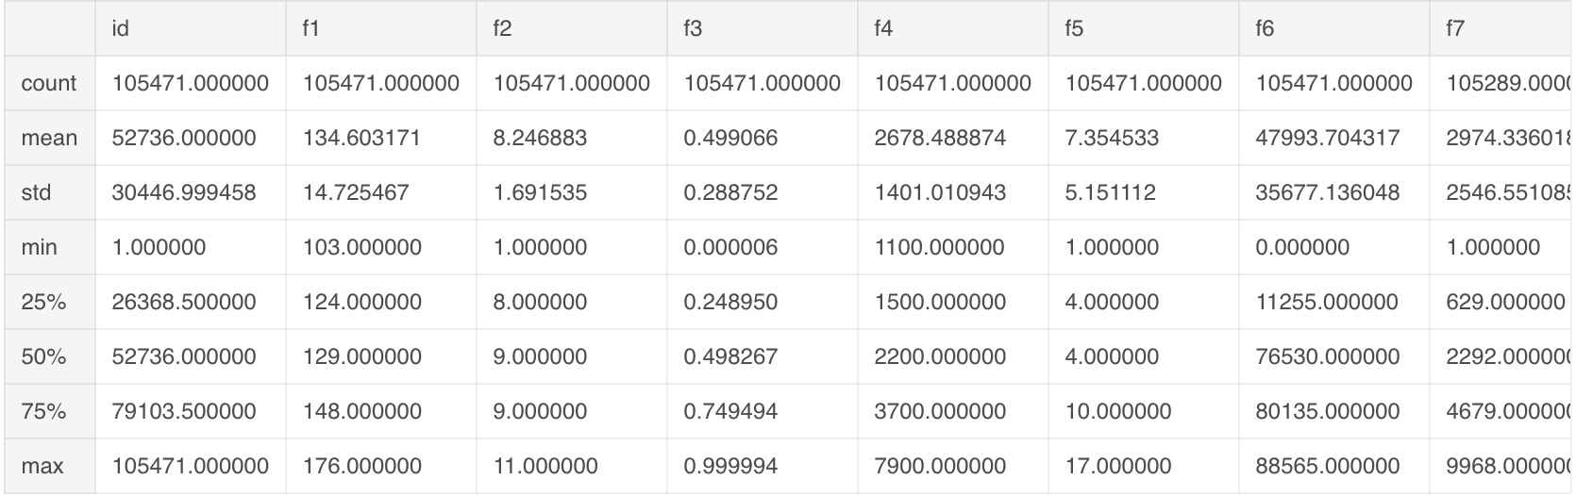
Statistical Analysis and Data Exploration
Massive Data: 105,471 observations with 778 variables and an output variable of loss
Main Statistics: We looked at the following statistics to understand the data: count, mean, standard deviation, min, 25%, 50%, 75% and max. But we couldn’t understand much since our data was anonymized.
Output: Our output (y_variable) is losses which is also shown in the histogram on right
Histogram

Slide 5
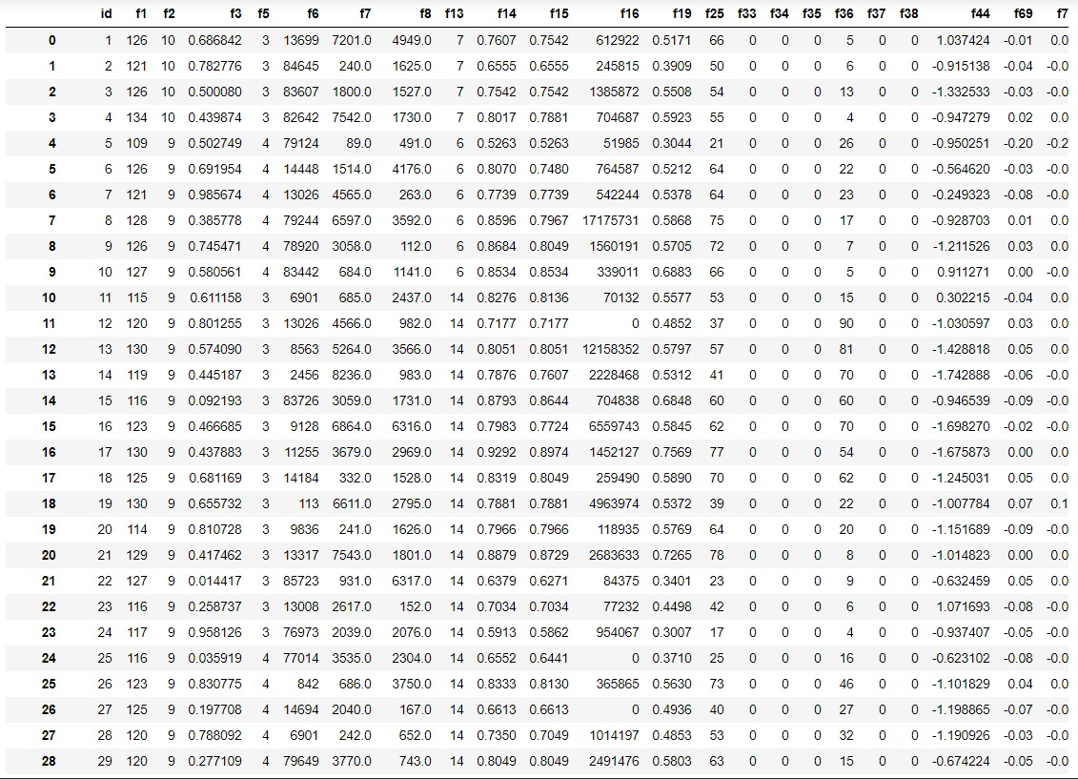
Raw Data (778 variables, 105K observations)

Slide 6
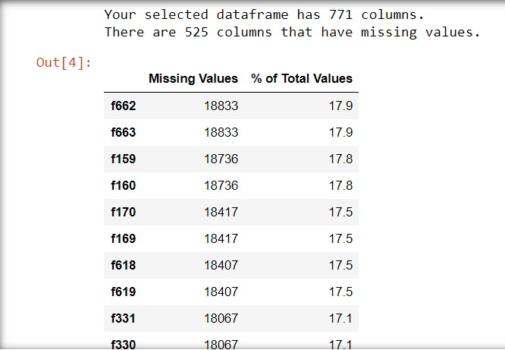
Cleaning the Data
Standardize the features: During the data exploration we realized the data is very unstandard. Since the data is anonymous we standardized the data by transforming it into a standard scalar vector
Drop NAs: 525 of our variables (776 total) had at least one of their observations missing. Some features like f662 has 17.9% of it’s observations missing. We filled NAs with the mean of all observations remaining in that feature.
Removing Collinearity: We realized many of the features were proxying for similar things as we realized the correlation of many features was very high with each other. In order to reduce this collinearity, we decide to eliminate some of these features. We calculated a correlation matrix. In order to eliminate most features we can (to gain some computing power) we set a threshold like 0.6, and eliminated one of each features that his correlation higher than 0.6.

Slide 7
Random Forest Model
Data: First, we randomly split the data into two as the following: 80% Train, 20% Test.
Train: Later we trained the model with the train data by using “ExtraTreesClassifier” function from scikit-learn library with n_estimators = 250).
Features: We fitted the model and calculated the importance score of each feature. Later we listed the features according to their importance scores.
Prioritization of Features: Using an extra tree classifier we analysed the importance of each feature and realized that some features have no impact on the classification, except one feature, mainly FX, rest of the features has pretty similar impact and the overall impact for each feature is low, meaning the combination of features is more important than a couple of main features.
kaggle_loan_data.csv
Train Data
Test Data
80%
20%
X_train
y_train
X_test
y_test

Slide 8
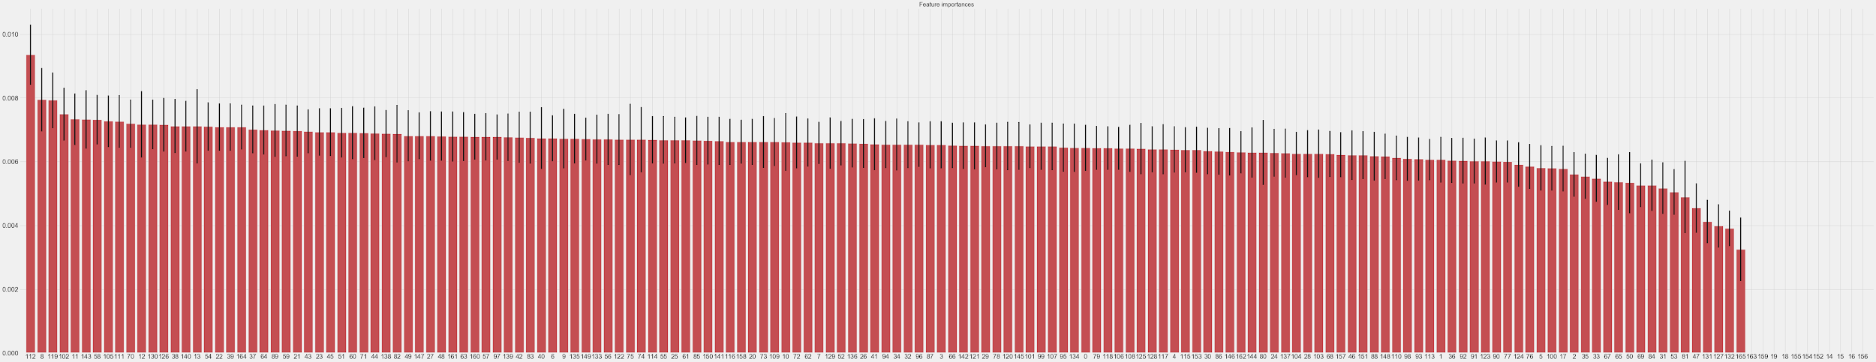
List of Features, sorted in their importance
forest.fit(X, y)
importances = forest.feature_importances_
std = np.std([tree.feature_importances_ for tree in forest.estimators_],
axis=0)
indices = np.argsort(importances)[::-1]
# Build a forest and compute the feature importances
forest = ExtraTreesClassifier(n_estimators=250,
random_state=0)

Slide 9
Final Results
Testing the Model with Test Data: After fitting the train data (X_train, y_train) with a random forest model, we tested the success of our model by looking at Mean Absolute Errors with a cross validation score on the test data we previously separated randomly.
Cross Validation Score: Our cross validation score was 0.9066, which was higher than some solution attempts posted on Kaggle.
Graph Limitations: As our decision tree had 166 features, it was not intuitive to plot the graph for this.
Cross Validation Calculation with Mean Absolute Error
# Function to calculate mean absolute error
def cross_val(X_train, y_train, model):
from sklearn.model_selection import cross_val_score
accuracies = cross_val_score(estimator = model, X = X_train, y = y_train, cv = 5)
return accuracies.mean()

Slide 10
Resources:
Kaggle Competition
https://www.kaggle.com/c/loan-default-prediction/overview
Dropbox Link for Our Data (kaggle_loan_data.csv)
https://www.dropbox.com/s/t67zsa44iebunwa/kaggle_loan_data.csv?dl=0
Scikit Learn Random Forest Classifier Documentations
https://scikit-learn.org/stable/modules/generated/sklearn.ensemble.RandomForestClassifier.html
https://scikit-learn.org/stable/modules/cross_validation.html
Random Forest Blogs on Medium.com
https://medium.com/@williamkoehrsen/random-forest-simple-explanation-377895a60d2d
https://medium.com/datadriveninvestor/k-fold-cross-validation-6b8518070833
https://towardsdatascience.com/the-random-forest-algorithm-d457d499ffcd

